Slide 1
CS F222: Discrete Structures
for
Computer Science
Topic: Algebraic Structures
Dr. Raghunath Reddy

Slide 2
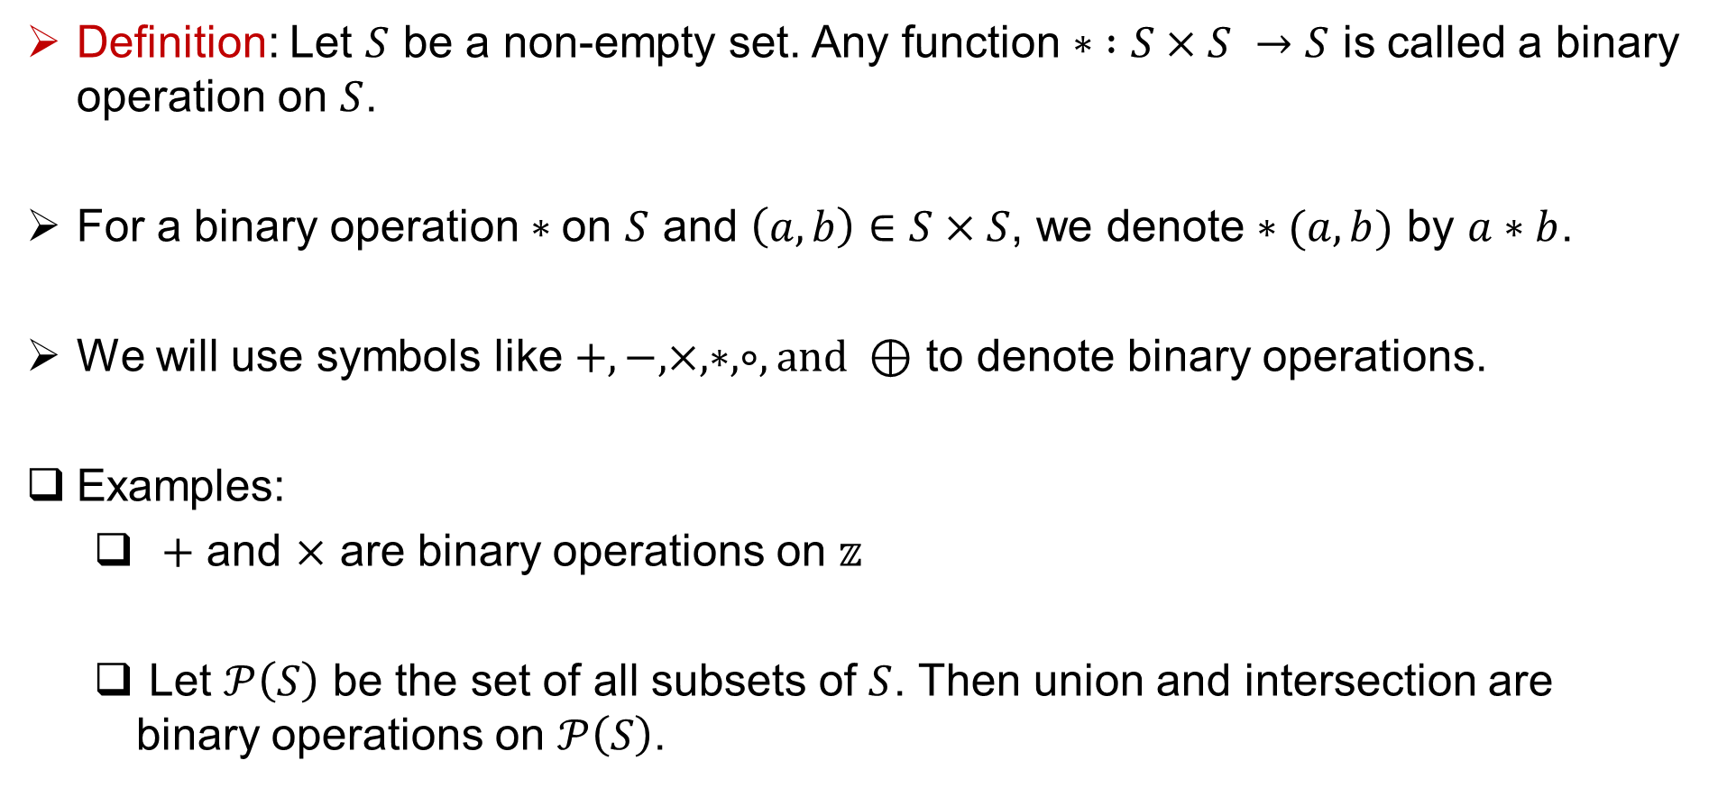
Binary Operations
Definition: Let $S$ be a non-empty set. Any function $∗ :S×S →S$ is called a binary operation on $S$.
For a binary operation $∗$on $S$ and $\left(a, b\right)∈S×S$, we denote $∗(a,b)$ by $a∗b$.
We will use symbols like $+, −, ×, ∗, ∘, and ⊕$ to denote binary operations.
Examples:
$+$ and $×$ are binary operations on $𝕫$
Let $𝒫\left(S\right)$ be the set of all subsets of $S$. Then union and intersection are binary operations on $𝒫\left(S\right)$.

Slide 3
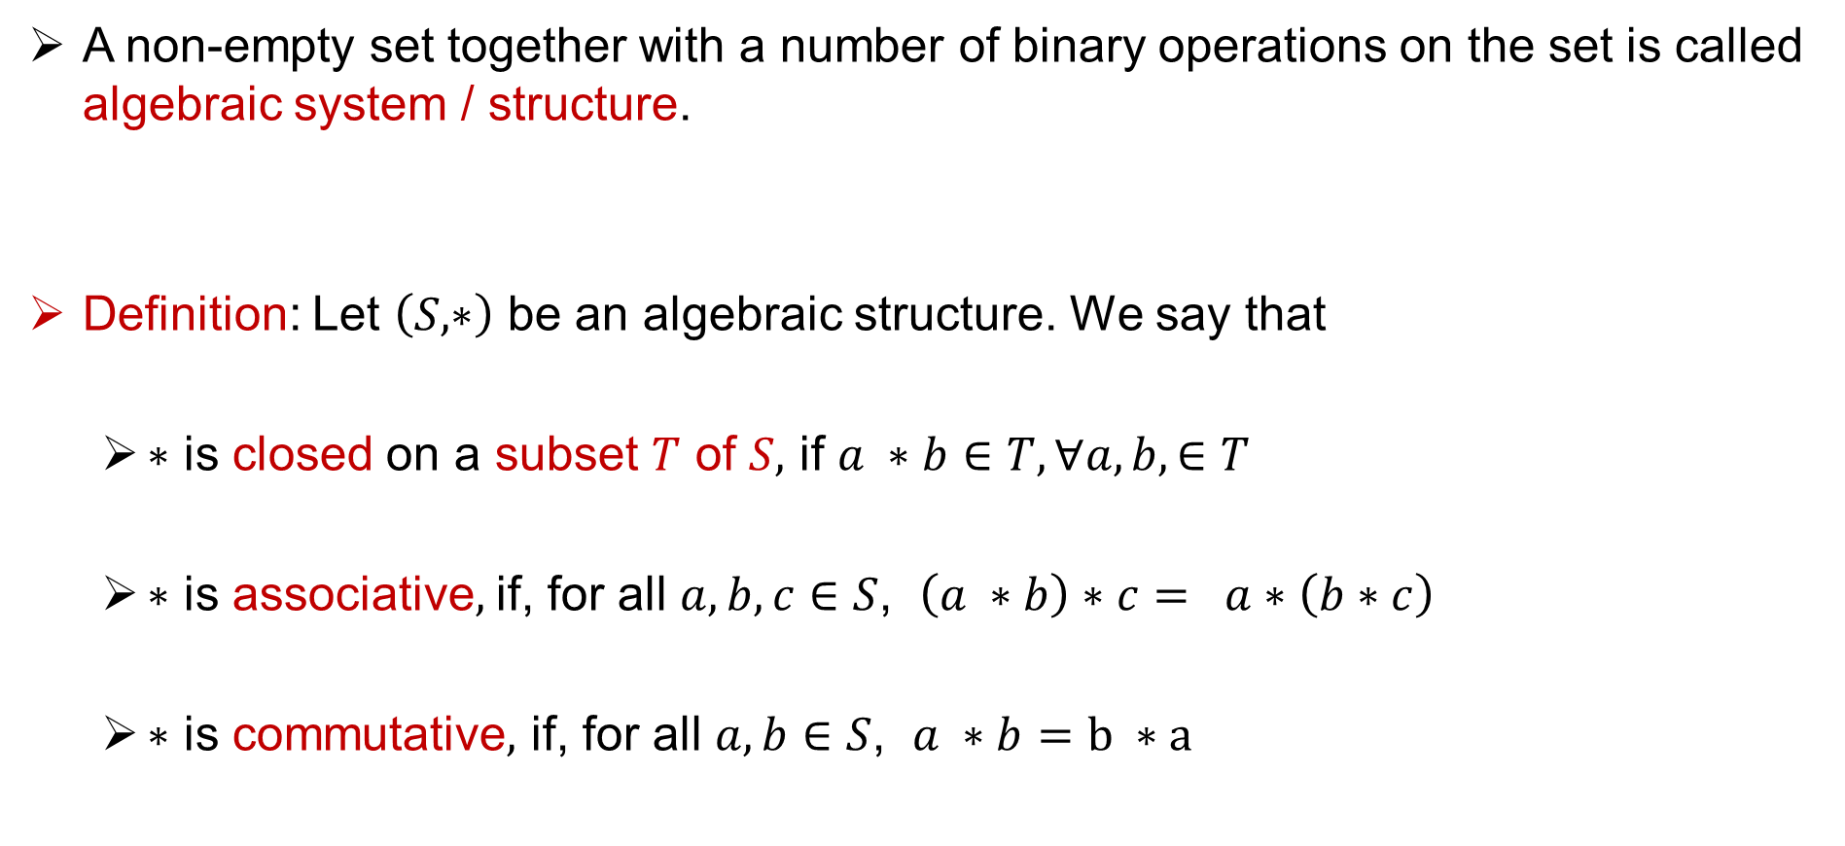
Algebraic structure and properties
A non-empty set together with a number of binary operations on the set is called algebraic system / structure.
Definition: Let $\left(S, ∗\right)$ be an algebraic structure. We say that
$∗$ is closed on a subset $T$ of $S,$ if $a ∗b∈T, ∀a, b, ∈T$
$∗$ is associative$,$ if, for all $a, b, c∈S$, $\left(a ∗b\right)∗c= a∗\left(b∗c\right)$
$∗$ is commutative$,$ if, for all $a, b∈S$, $a ∗b=b ∗a$

Slide 4
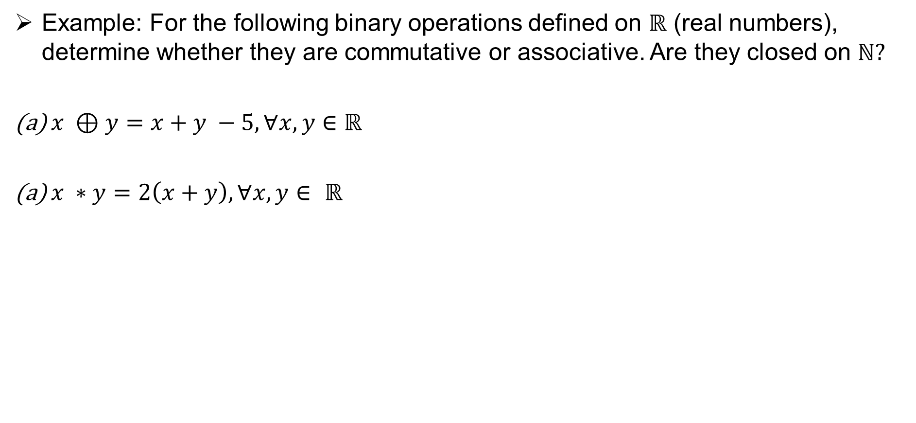
Algebraic structure and properties
Example: For the following binary operations defined on $ℝ$ (real numbers), determine whether they are commutative or associative. Are they closed on $ℕ?$
$x ⊕y=x+y −5, ∀x, y∈$ $ℝ$
$x ∗y=2\left(x+y\right),∀x, y∈ ℝ$

Slide 5
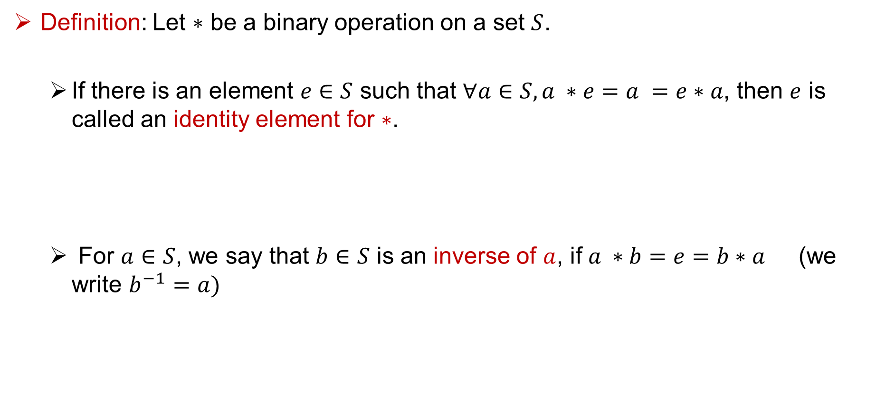
Identity and Inverse elements
Definition: Let $∗$ be a binary operation on a set $S$.
If there is an element $e∈S$ such that $∀a∈S, a ∗e=a =e∗a$, then $e$ is called an identity element for $∗$.
For $a∈S$, we say that $b∈S$ is an inverse of $a$, if $a ∗b=e=b∗a$ (we write $b^{−1}=a)$

Slide 6
Identity and Inverse elements
Definition: Let $∗$ be a binary operation on a set $S$.
If there is an element $e∈S$ such that $∀a∈S, a ∗e=a =e∗a$, then $e$ is called an identity element for $∗$.
For $a∈S$, we say that $b∈S$ is an inverse of $a$, if $a ∗b=e=b∗a$ (we write $b^{−1}=a)$

Slide 7
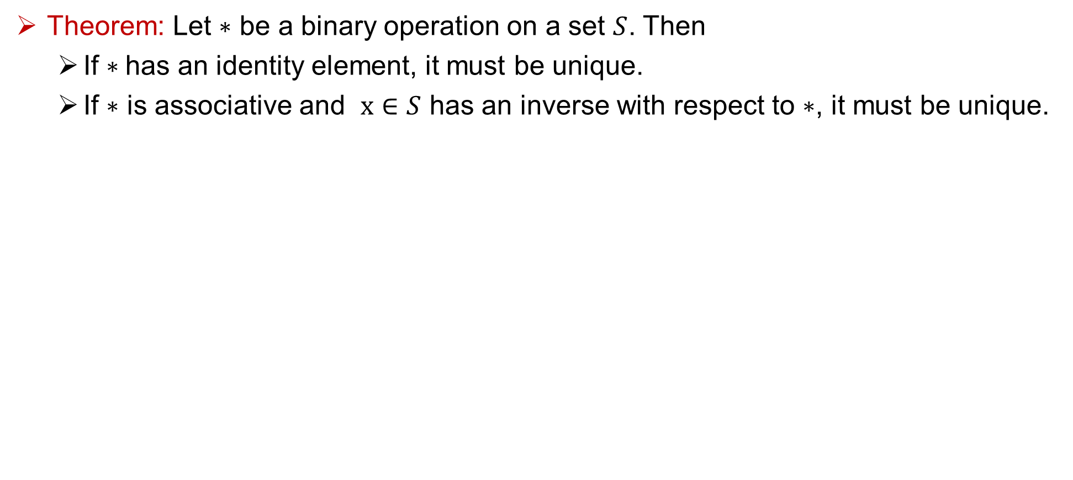
Identity and Inverse elements
Theorem: Let $∗$ be a binary operation on a set $S$. Then
If $∗$has an identity element, it must be unique.
If $∗$ is associative and $x∈S$ has an inverse with respect to $∗$, it must be unique.

Slide 8
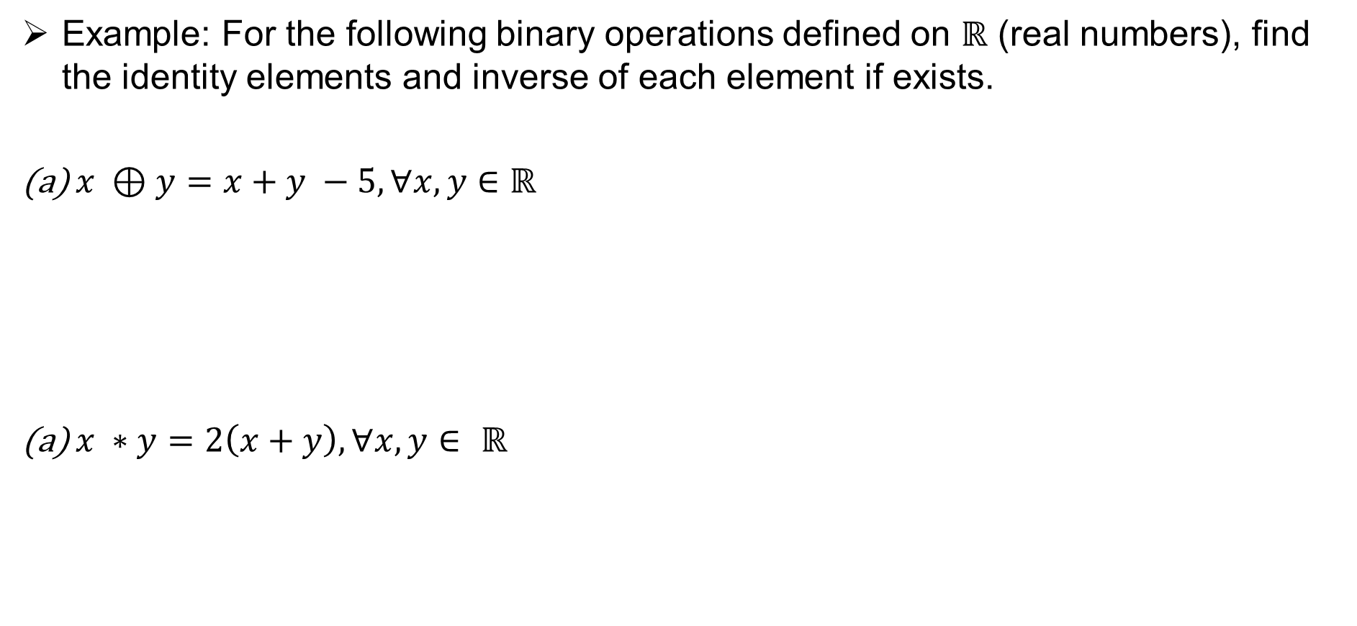
Algebraic structure and properties
Example: For the following binary operations defined on $ℝ$ (real numbers), find the identity elements and inverse of each element if exists.
$x ⊕y=x+y −5, ∀x, y∈$ $ℝ$
$x ∗y=2\left(x+y\right),∀x, y∈ ℝ$

Slide 9
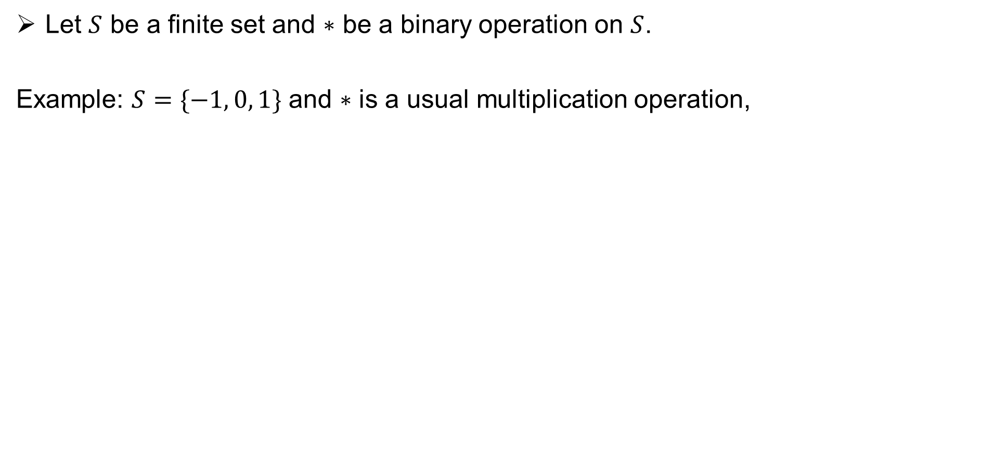
Cayley table / Operations table
Let $S$ be a finite set and $∗$ be a binary operation on $S$.
Example: $S=\{−1, 0, 1\}$ and $∗$ is a usual multiplication operation,

Slide 10
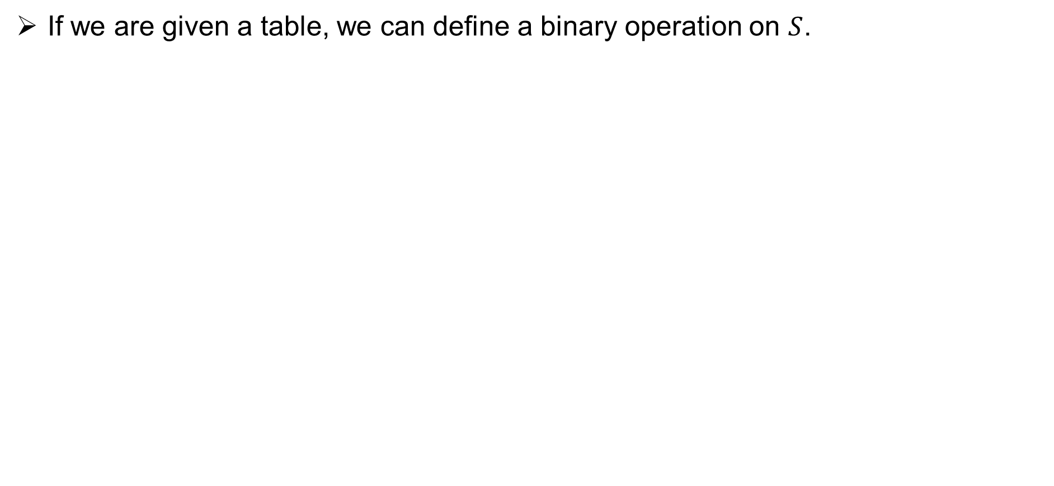
Cayley table / Operations table
If we are given a table, we can define a binary operation on $S$.
* | 1 | 2 | 3
1 | 1 | 2 | 3
2 | 3 | 1 | 2
3 | 2 | 3 | 1

Slide 11
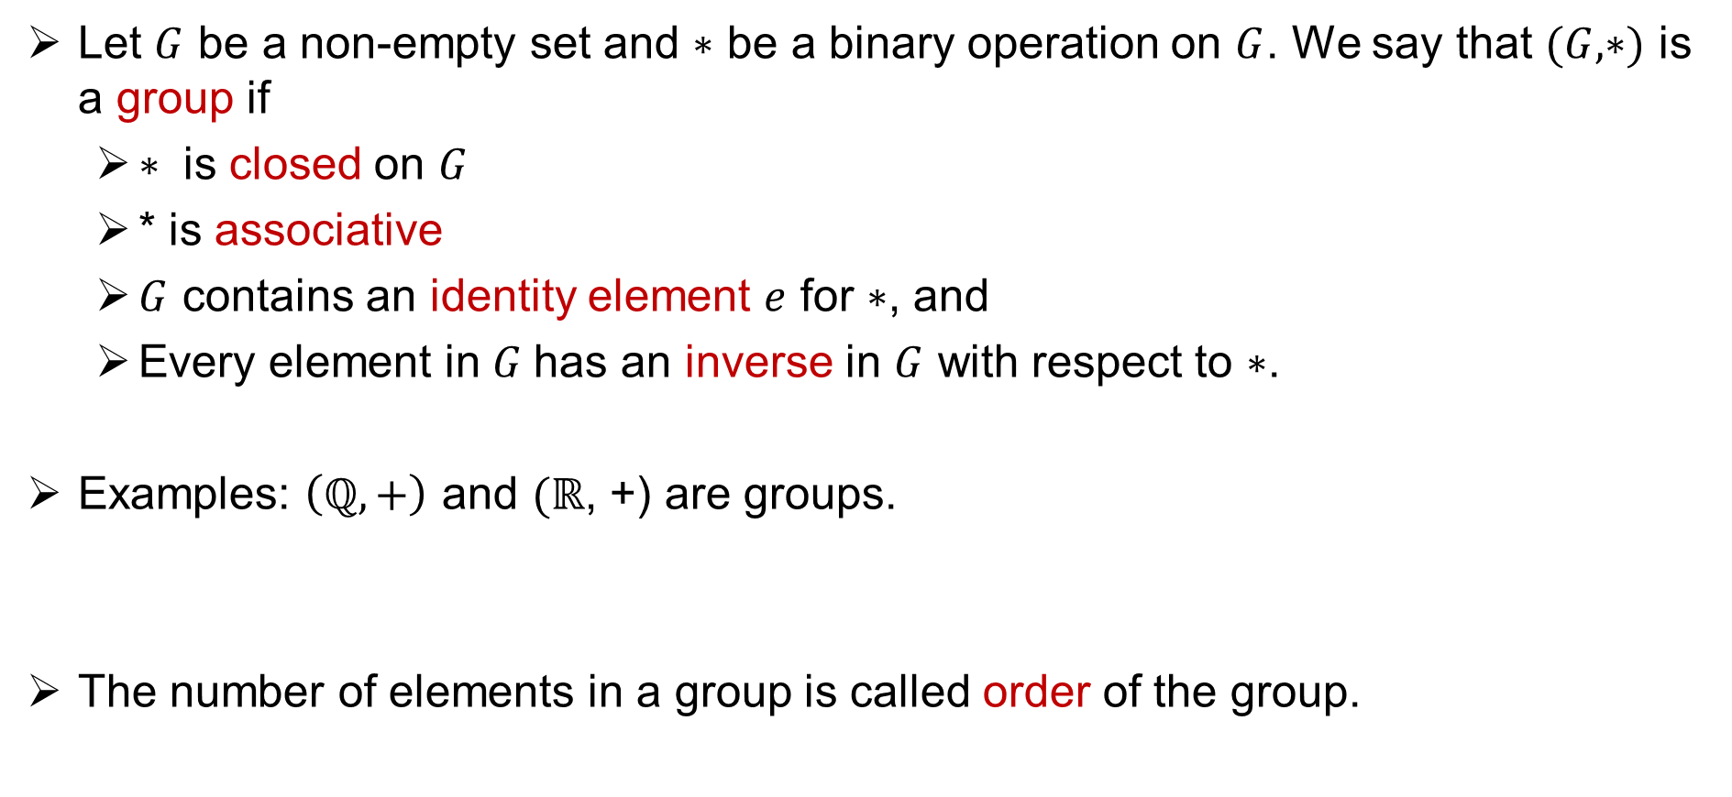
Group
Let $G$ be a non-empty set and $∗$ be a binary operation on $G$. We say that $(G, ∗)$ is a group if
$∗$ is closed on $G$
* is associative
$G$ contains an identity element $e$ for $∗$, and
Every element in $G$has an inverse in $G$ with respect to $∗$.
Examples: $\left(ℚ, +\right)$ and $(ℝ$, +) are groups.
The number of elements in a group is called order of the group.

Slide 12
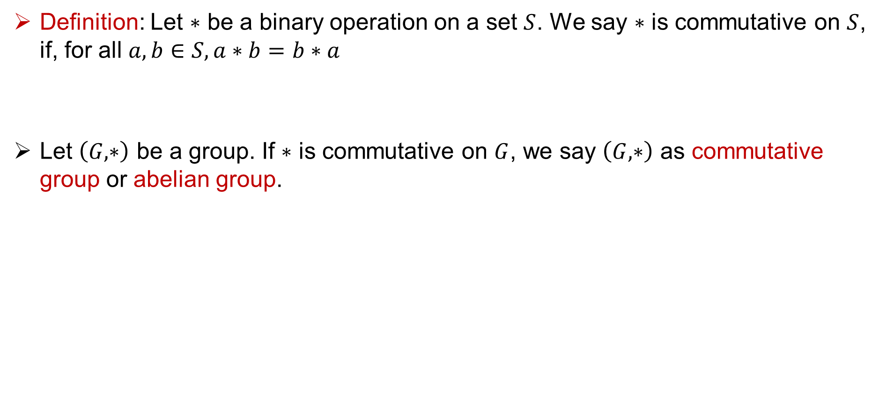
Commutative property
Definition: Let $∗$ be a binary operation on a set $S$. We say $∗$ is commutative on $S$, if, for all $a, b∈S, a∗b=b∗a$
Let $\left(G, ∗\right)$ be a group. If $∗$ is commutative on $G$, we say $\left(G, ∗\right)$ as commutative group or abelian group.

Slide 13
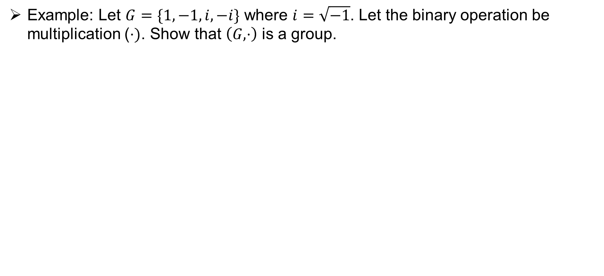
Group: Examples
Example: Let $G=\{1, −1, i, −i\}$ where $i=\sqrt{−1}$. Let the binary operation be multiplication ($⋅)$. Show that $\left(G, ⋅\right)$ is a group.

Slide 14
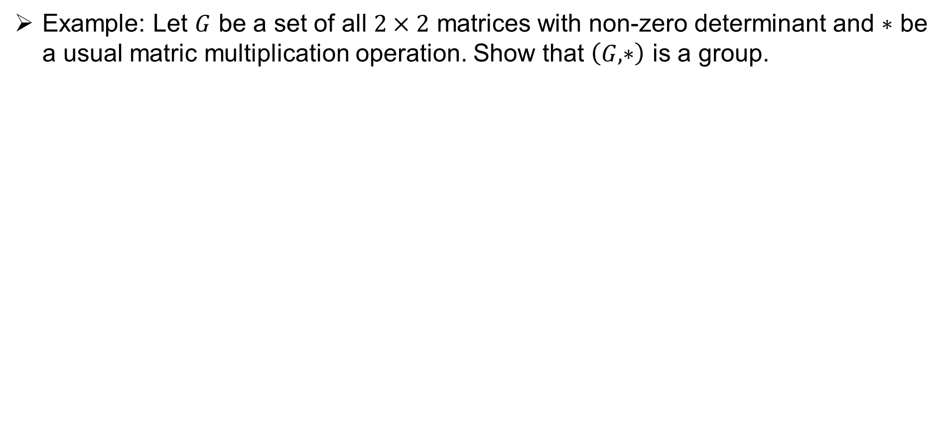
Group : Examples
Example: Let $G$ be a set of all $2×2$ matrices with non-zero determinant and $∗$ be a usual matric multiplication operation. Show that $\left(G, ∗\right)$ is a group.

Slide 15
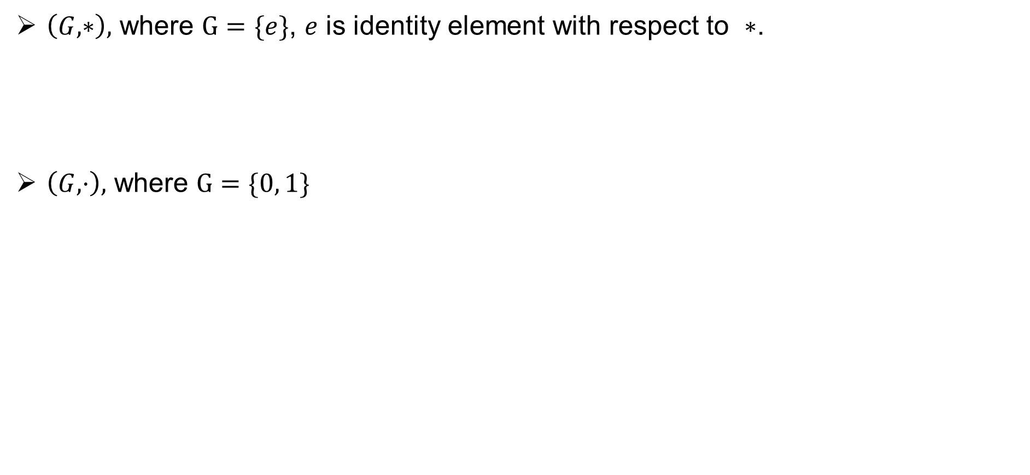
Some finite Group examples
$\left(G, ∗\right),$ where $G=\{e\}$, $e$ is identity element with respect to $∗$.
$\left(G, ⋅\right),$ where $G=\{0, 1\}$

Slide 16
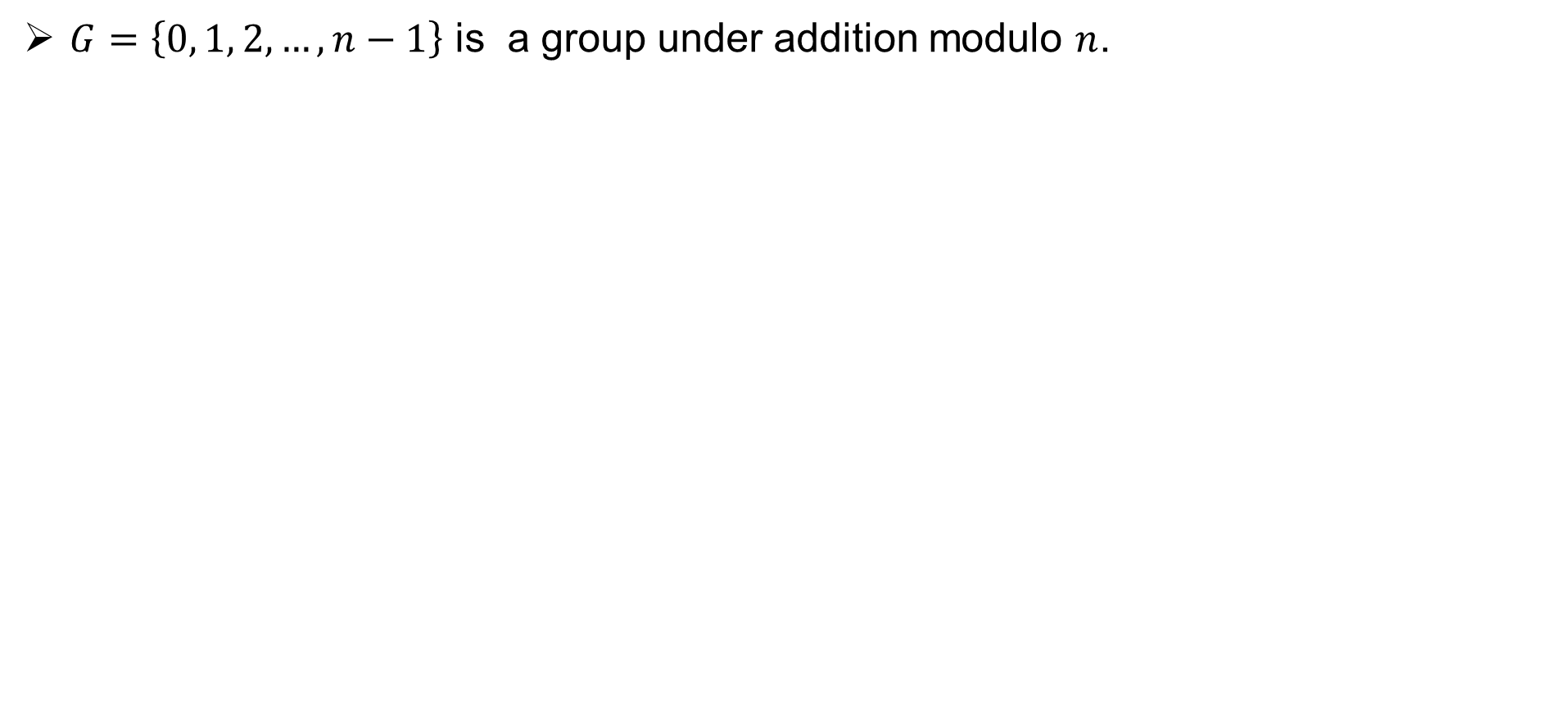
Some more finite Group examples
$G=\left\{0, 1, 2, …, n−1\right\}$ is a group under addition modulo $n$.

Slide 17
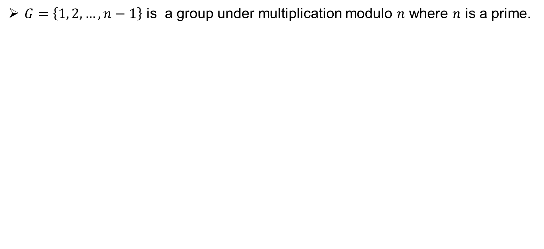
Some more finite Group examples
$G=\left\{1, 2, …, n−1\right\}$ is a group under multiplication modulo $n$ where $n$ is a prime.

Slide 18

Properties of Groups
Theorem: Let $\left(G, ∗\right)$ be a group. For $a, b, c∈G$,
If $a ∗b=a ∗c ,$ then $b=c$
If $b ∗a=c ∗a$, then $b=c$

Slide 19

Properties of Groups
Theorem: Let $(G, ∗)$ be a group. Then
${\left(a^{−1}\right)}^{−1}=a$ for every element $a∈G$.
${\left(a∗b\right)}^{−1}=b^{−1}∗a^{−1}$ for all $a, b∈G$.

Slide 20
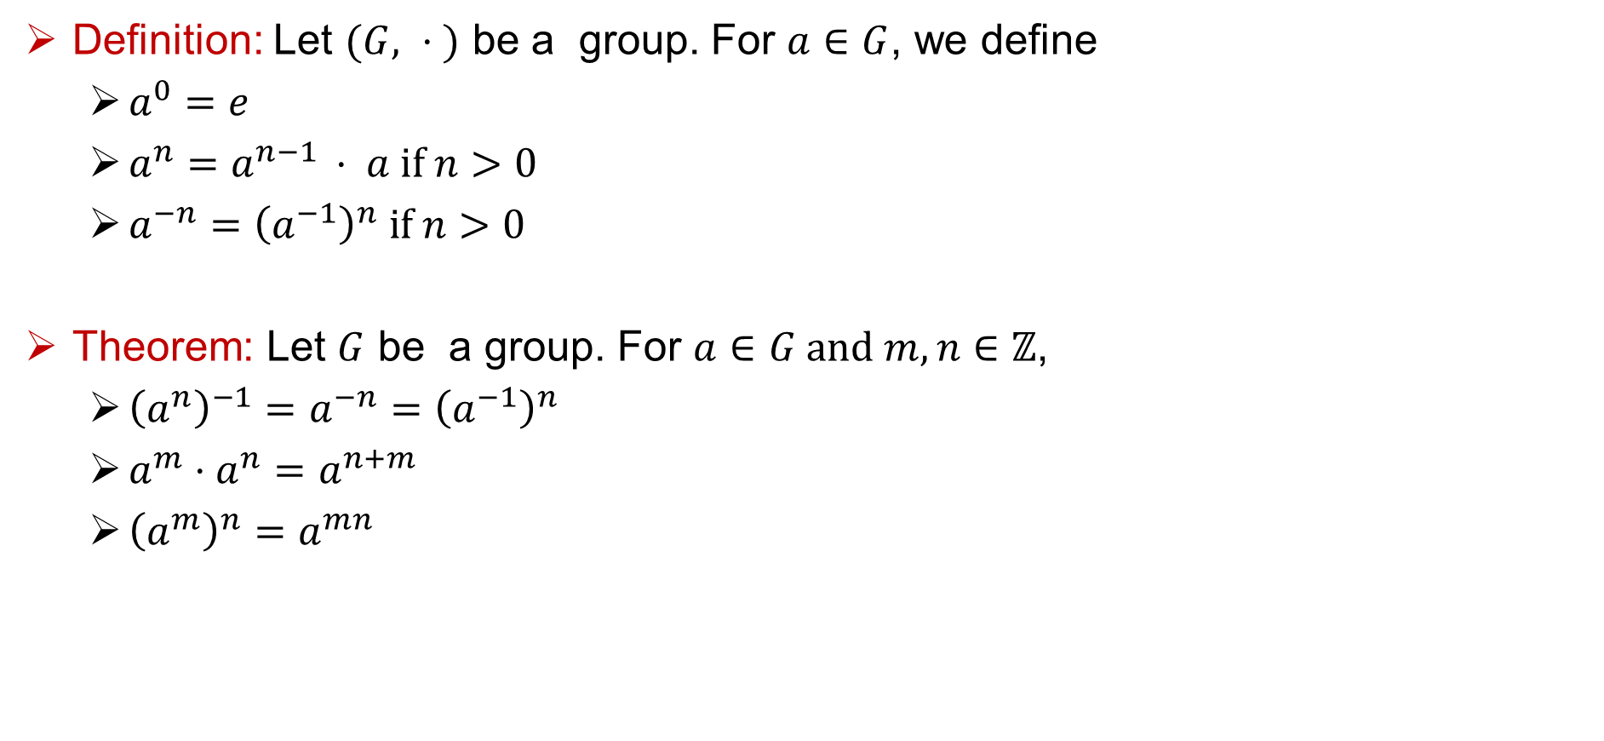
Exponent of an element
Definition: Let $(G, ⋅ )$ be a group. For $a∈G$, we define
$a^{0}=e$
$a^{n}=a^{n−1 }⋅ a if n>0$
$a^{−n}={\left(a^{−1}\right)}^{n} if n>0$
Theorem: Let $G$ be a group. For $a∈G and m,n∈ℤ$,
${\left(a^{n}\right)}^{−1}=a^{−n}={\left(a^{−1}\right)}^{n}$
$a^{m}⋅a^{n}=a^{n+m }$
${\left(a^{m}\right)}^{n}=a^{mn}$

Slide 21
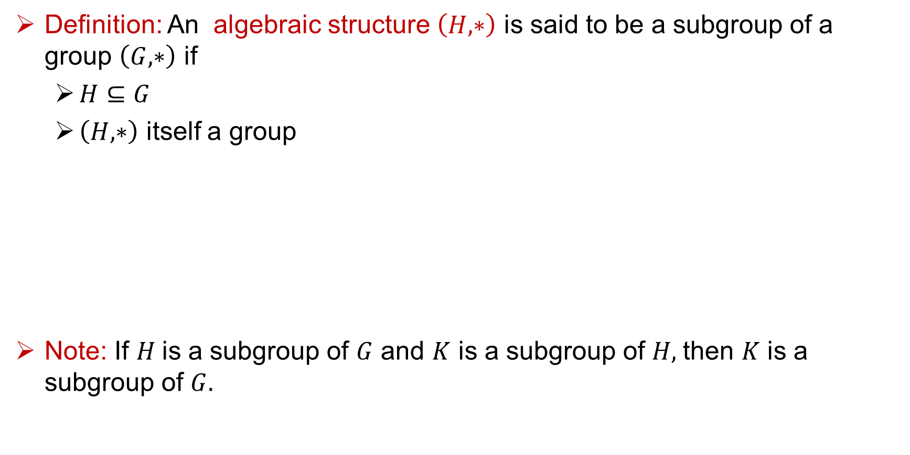
Subgroups
Definition: An algebraic structure $\left(H, ∗\right)$ is said to be a subgroup of a group $\left(G, ∗\right)$ if
$H⊆G$
$\left(H, ∗\right)$ itself a group
Note: If $H$is a subgroup of $G$ and $K$ is a subgroup of $H,$then $K$ is a subgroup of $G.$

Slide 22
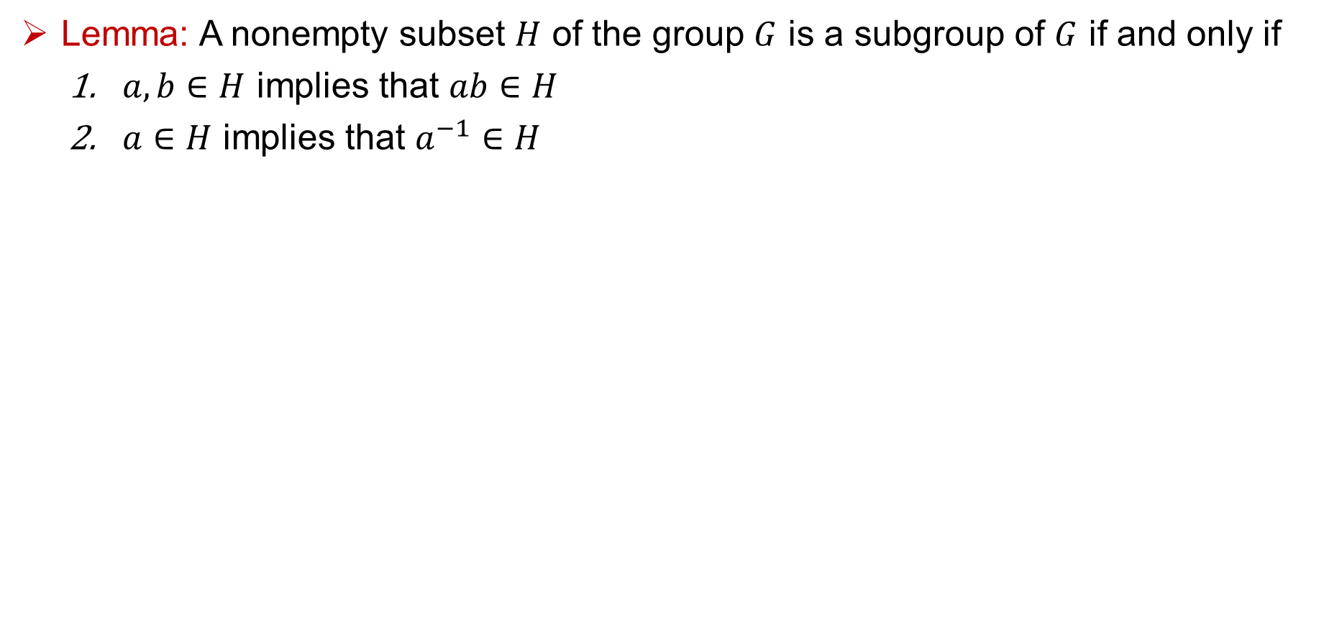
Subgroups
Lemma: A nonempty subset $H$ of the group $G$ is a subgroup of $G$ if and only if
$a, b∈H$ implies that $ab∈H$
$a∈H$ implies that $a^{−1}∈H$

Slide 23
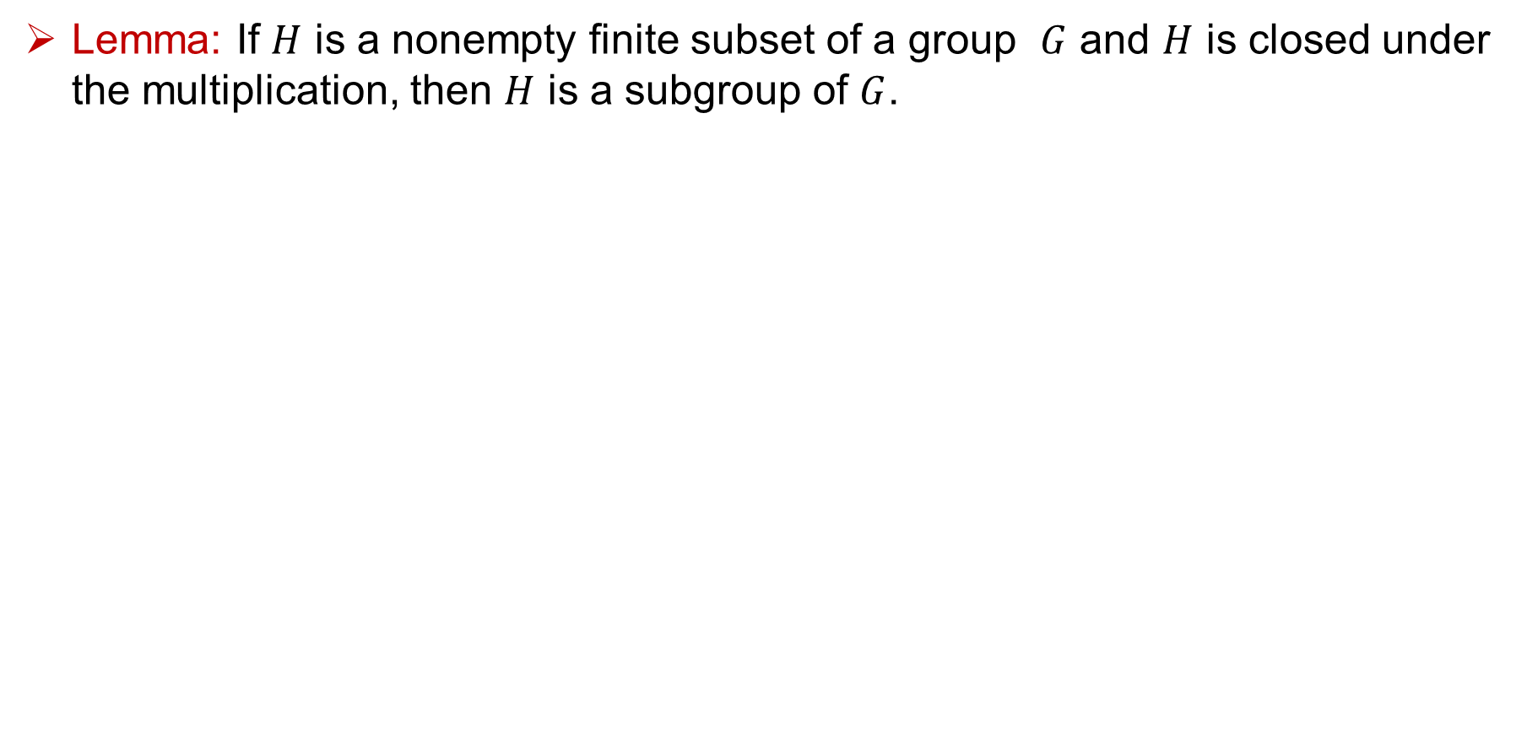
Subgroups
Lemma: If $H$ is a nonempty finite subset of a group $G$ and $H$ is closed under the multiplication, then $H$ is a subgroup of $G$.

Slide 24
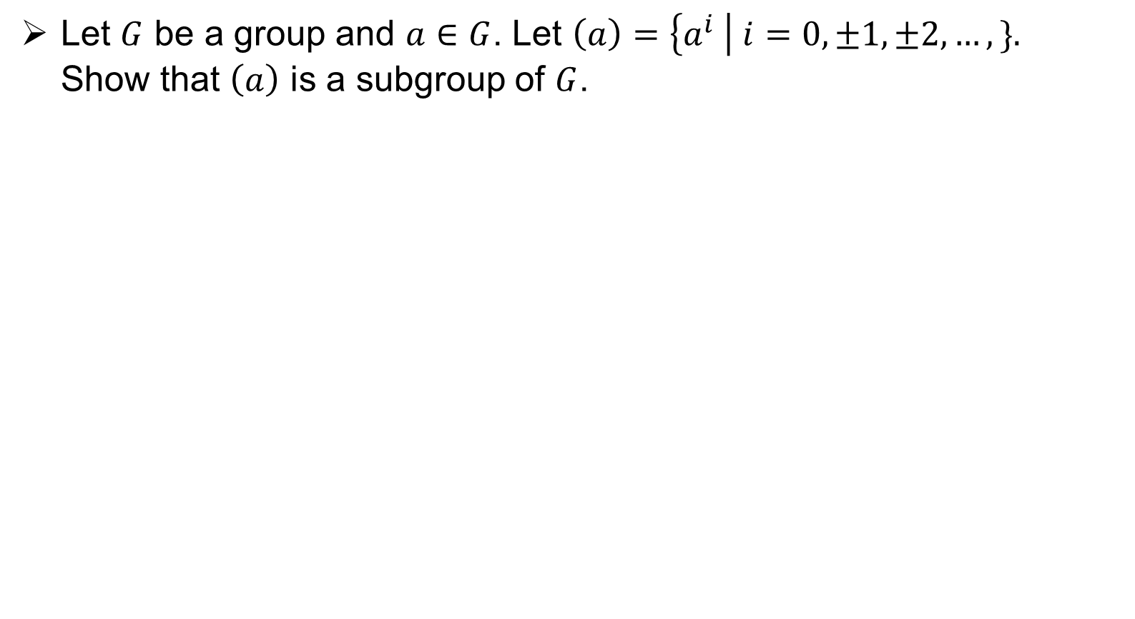
Subgroups
Let $G$ be a group and $a∈G$. Let $\left(a\right)=\left\{a^{i} \right| i=0, ±1, ±2, …, \}.$ Show that $\left(a\right)$ is a subgroup of $G$.

Slide 25
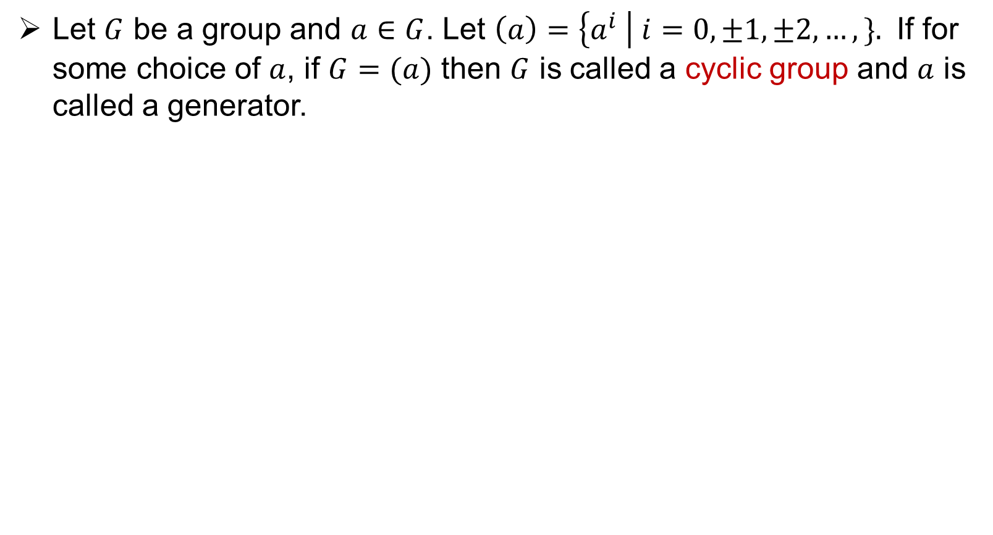
Cyclic groups
Let $G$ be a group and $a∈G$. Let $\left(a\right)=\left\{a^{i} \right| i=0, ±1, ±2, …, \}.$ If for some choice of $a$, if $G=(a)$ then $G$ is called a cyclic group and $a$ is called a generator.

Slide 26
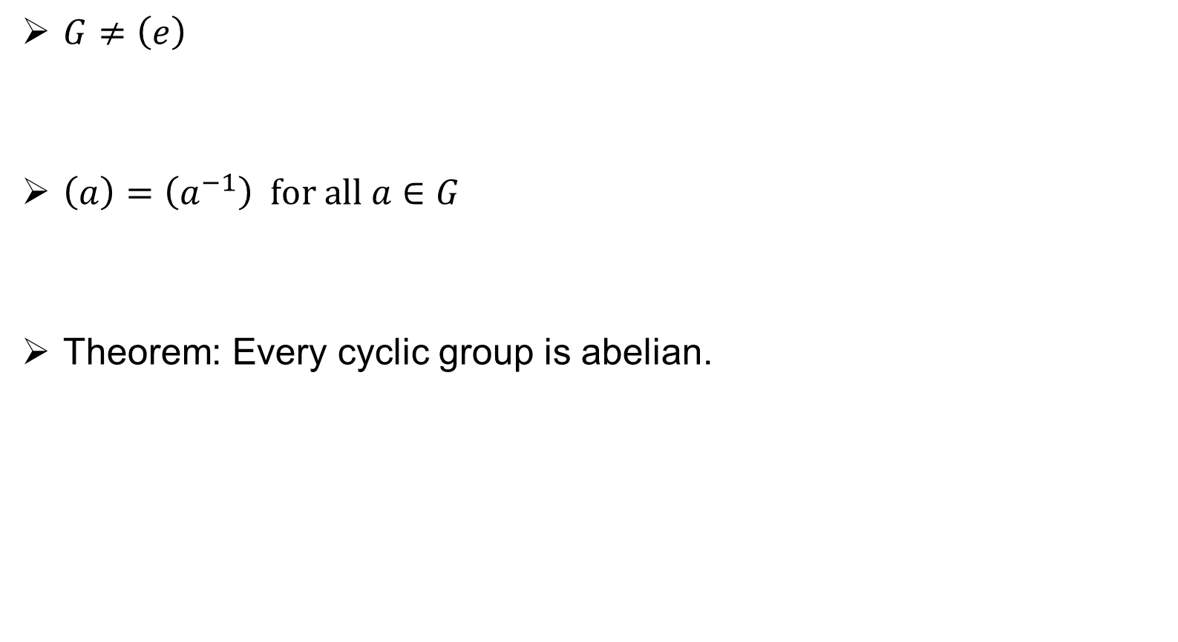
Cyclic groups
$G≠\left(e\right)$
$\left(a\right)=\left(a^{−1}\right) for all a∈G$
Theorem: Every cyclic group is abelian.

Slide 27
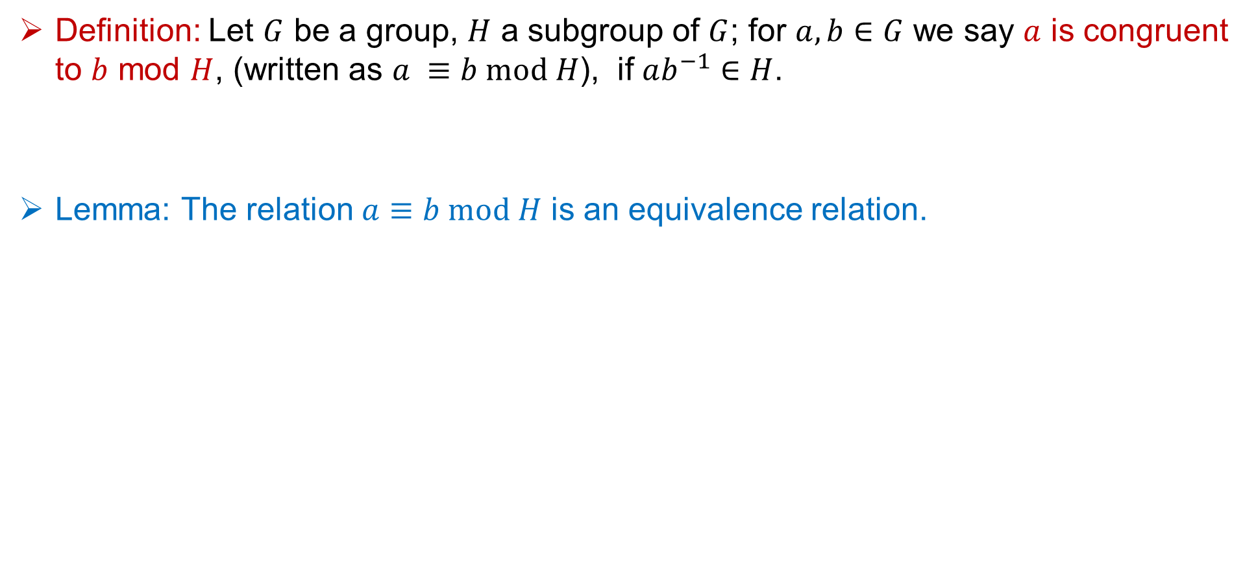
Congruent modulo H
Definition: Let $G$ be a group, $H$ a subgroup of $G$; for $a, b∈G$ we say $a$ is congruent to $b$ mod $H$, (written as $a ≡b mod H$), if $ab^{−1}∈H$.
Lemma: The relation $a≡b mod H$ is an equivalence relation.

Slide 28

Cosets
Definition: If $H$ is a subgroup of $G$, $a∈G$, then $Ha=\left\{ha \right|h in H\}$.
$Ha$ is called a right coset of $H$ is G.

Slide 29
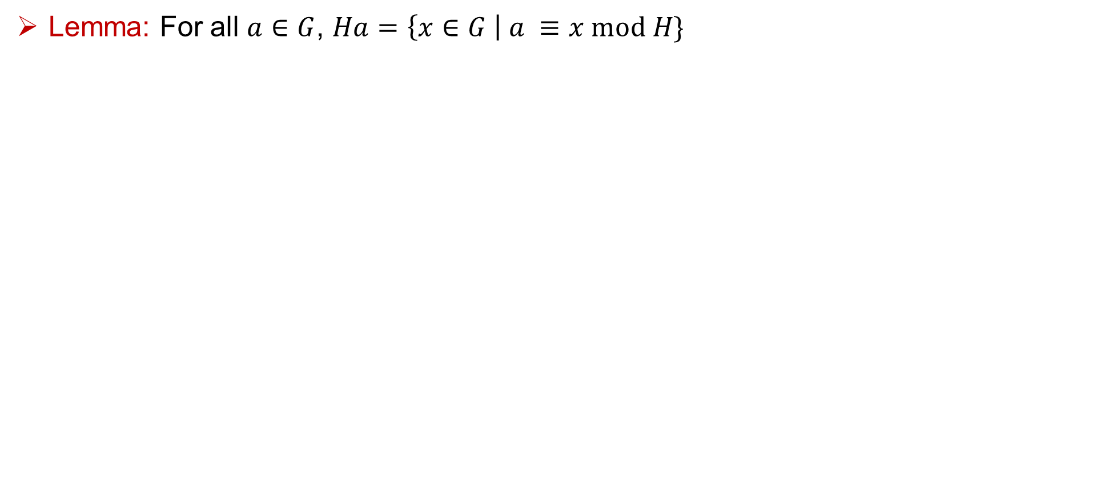
Cosets
Lemma: For all $a∈G$, $Ha=\left\{x∈G \right| a ≡x mod H\}$

Slide 30
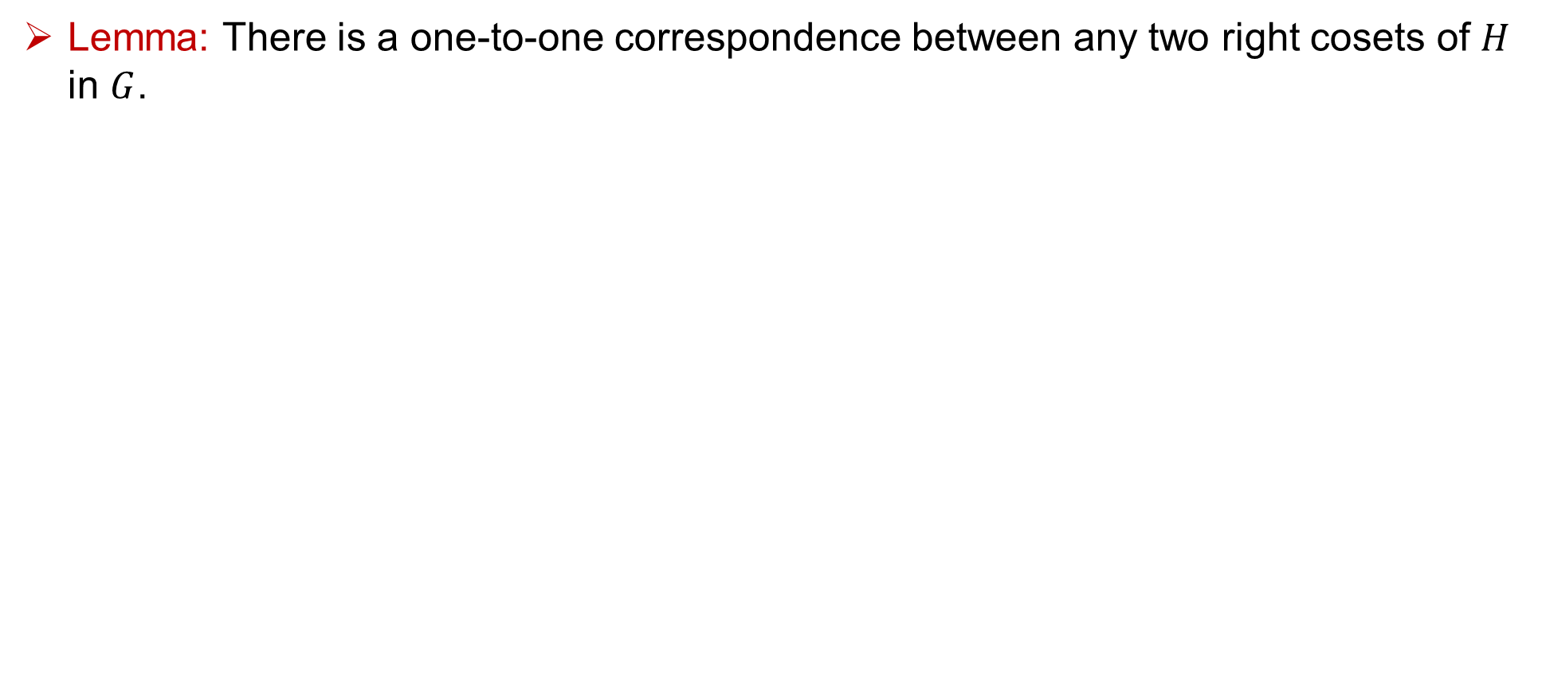
Cosets
Lemma: There is a one-to-one correspondence between any two right cosets of $H$ in $G$.

Slide 31

Cosets : Lagrange's theorem
Lemma: If $G$ is a finite group and $H$ is a subgroup of $G$, then $o\left(H\right)$ is a divisor of $o(G)$.

Slide 32
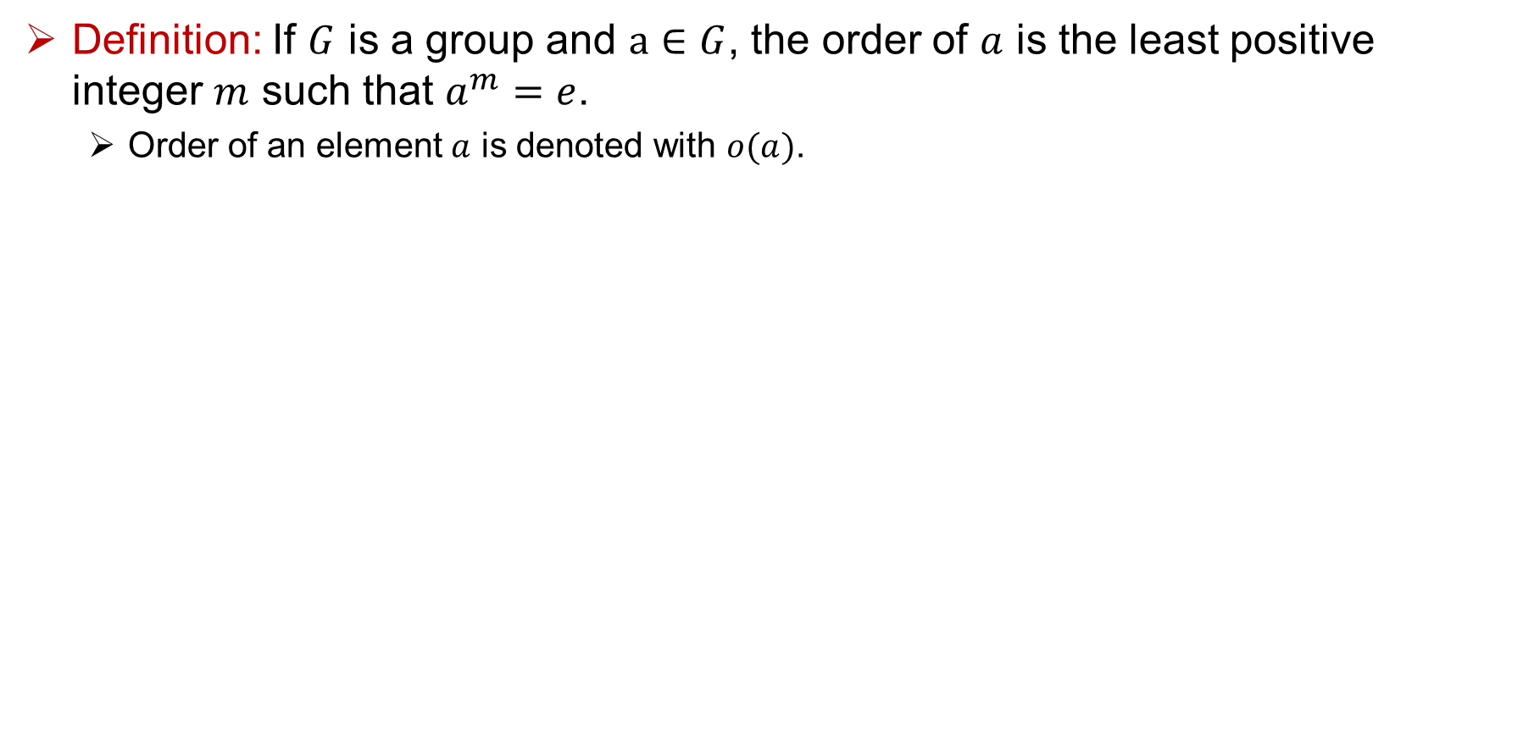
Order of an element
Definition: If $G$ is a group and $a∈G$, the order of $a$ is the least positive integer $m$ such that $a^{m}=e$.
Order of an element $a$ is denoted with $o(a)$.

Slide 33
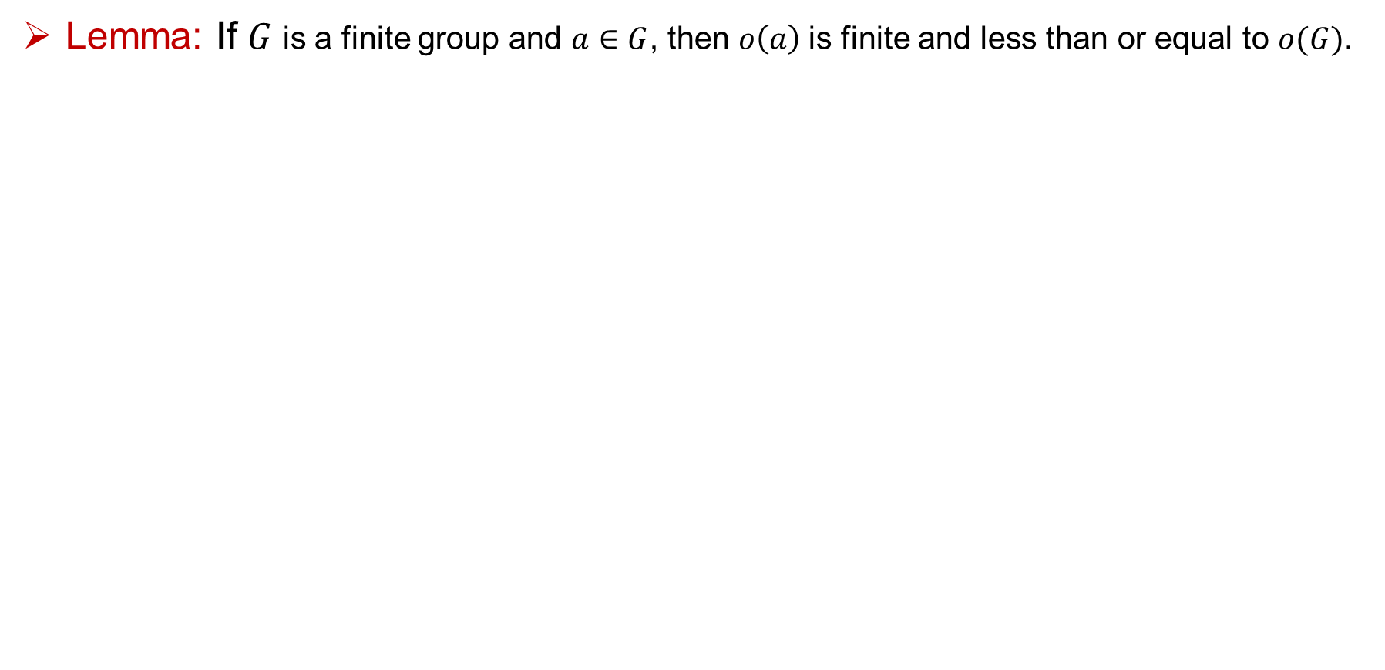
Order of an element
Lemma: If $G$ is a finite group and $a∈G$, then $o\left(a\right)$is finite and less than or equal to $o(G)$.

Slide 34

Order of an element
Lemma: If $G$ is a finite group and $a∈G$, then $o\left(a\right)$is a divisor of $O(G)$.

Slide 35
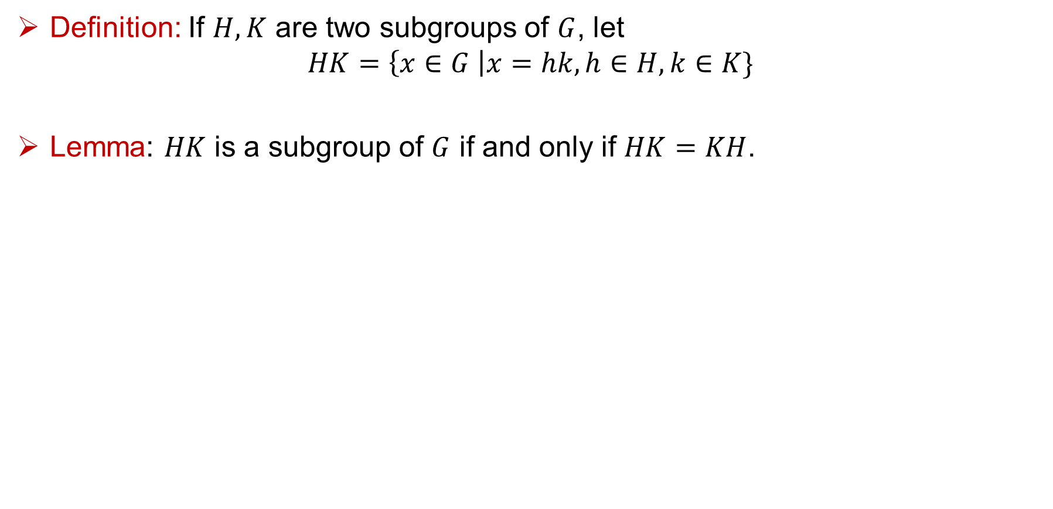
Product of two subgroups
Definition: If $H, K$ are two subgroups of $G$, let
$$HK=\left\{x∈G \right|x=hk, h∈H, k∈K\}$$
Lemma: $HK$ is a subgroup of $G$ if and only if $HK=KH$.

Slide 36
Thank You!!

